Slide 1
LEG Pilot
Video-conference call – VC#1, 21 November 2019
Tools for LEG Self-Assessment and
Performance Feedback

Slide 2
Welcome - introductions
Participating countries - expressions of interest received so far:
[Africa – cluster 1] | [Africa – cluster 2] | Countries in other parts of the world
The Gambia | Burundi | Guyana
Ghana | Cape Verde | Uzbekistan
Malawi | Congo, DR | Yemen
Mozambique | Senegal | Papua New Guinea
Rwanda |  | Pakistan Sindh
Sao Tome and Principe
Zambia
Additional countries are welcome to join the pilot

Slide 3
Why this pilot?
This pilot emerged out of the Effective Partnership Rollout (EPR) - an initiative that aims to:
improve the effectiveness and efficiency of Partnership’s country-level operations.
Key changes introduced by the EPR include:
Adjustments to country level roles and accountabilities
Operational adjustments
Pilots and new mechanisms
Strategic planning and next steps

Slide 4
Today’s agenda and objectives
Overview of the pilot
Introducing the tools LEG self-assessment tool Performance feedback tool
Implementing the pilot Getting started - decisions
PIC

Slide 5
Overview of the pilot
Today’s Agenda
Introductions
Overview of the LEG pilot
Introducing the tools
Leg self-assessment tool
Performance feedback tool
Implementing the pilot
Roles and next steps

Slide 6
What does the pilot consist of?
.
Two tools, intended to
be complementary and mutually supporting
stimulate dialogue within the LEG for greater effectiveness and enhanced mutual accountability.
LEG self
Assessment Tool
A diagnostic tool to assess partnership effectiveness to be used collectively to identify opportunities for strengthening LEG
Performance Feedback Tool
A feedback tool to assess individual performance and contributions to the LEG for mutual accountability
Informed by evidence from multi-stakeholder partnership practices
Aligned with the GPE Charter

Slide 7
What does it aim to achieve?
Test the tools for their suitability, relevance, and user-friendliness across diverse country contexts
Revise tools and related guidance based on assessment results and in response to feedback from pilot countries practical guidance
1
2
And also:
Develop targeted practical guidance in response to identified needs to better support LEGs
3

Slide 8
Who does it aim to engage?
With these aims in mind, the pilot will ideally involve all LEG members but likely with different levels of engagement:
Ministry
representatives
Coordinating
agency
National
development
partners
International
development
partners
Grant
agent

Slide 9
What’s in it for me?
LEG members will have the opportunity to:
Identify opportunities to strengthen partnership and collaboration through the LEG in your country
Contribute to the refinement of the tools and their related guidance in view of their broader use
Engage with other pilot countries and GPE Secretariat (if desired) around LEG effectiveness

Slide 10
.
Q & A

Slide 11
Introducing the tools
Today’s Agenda
Introductions
Overview of the pilot
Introducing the tools
Leg self-assessment tool
Performance feedback tool
Implementing the pilot
Getting started

Slide 12
Performance feedback tool
Uses of the tools
Reflect on key actors’ performance and contributions to the LEG
Stimulate open and transparent discussion
Identify actions to improve partnership dynamics
Hold each other accountable
Reflect collectively
Stimulate dialogue with all LEG actors
Set priorities for the sector and the LEG
Strengthen or establish LEG TOR
Monitor the evolution of the LEG’s progress
LEG self-assessment tool
Different formats available to use the tools
Notes:
So first a bit on how they complement each other and their different uses.
The LEG self-assessment tool is a tool :
to facilitate a structured, collective reflection on the purposes and quality of policy dialogue currently occurring within the LEG;
This may help set priorities for improvement actions so that it increasingly becomes a body that is perceived as adding value for partnership strengthening
The tool could be in the context of reviewing/strengthening or establishing a LEG TOR to clarify key functions, roles and responsibilities, working arrangements, and expectations of LEG members.
The tool can also be used to create a baseline to monitor progress in LEG effectiveness from one assessment to the next.
- Now, the tool has three components to examin at LEG effectiveness, as we will see. One of them is Collaborative Capacities.
- And THIS is where the second tool comes in as a reinforcing element for assessing partnership dynamics
- The second tool allows to go deeper into these dynamics; and look at key actors engagement in the partnership, and is thereby a way to keep key actors accountable to each other
- This is essentially how these tools complement each other, and their different uses.

Slide 13
The LEG Self-Assessment Tool

Slide 14
LEG effectiveness
Agreed policy dialogue functions serving shared goals and priorities
Strategic effectiveness
Collaborative capacities
Arrangements making the LEG ‘fit-for-purpose’
Behaviors, values and commitments underpinning healthy partnership dynamics
Organizational capacities

Slide 15
DOC Principles toward effective LEGs

Slide 16
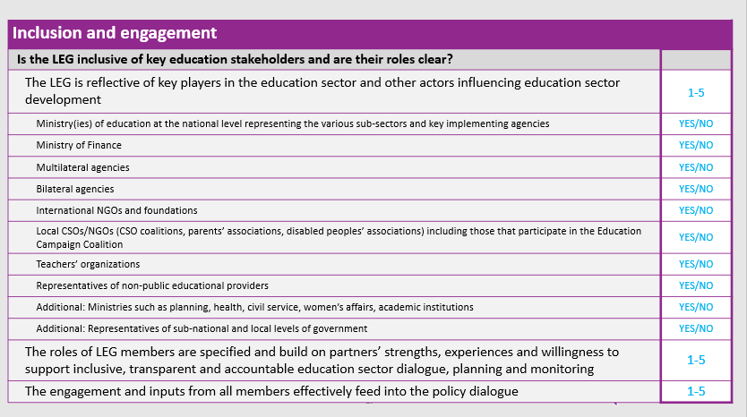
What it looks like
The tool in
POWERPOINT

Slide 17
Example of assessment questions
Clarity of mandate, functions and objectives
Does the LEG have a clear mandate and agreed functions?
LEG members share a common vision for the role and mandate of the LEG, reflected in documents such as LEG ToR, MoU, partnership framework, Charter etc. | 1-5
LEG’s core functions and membership were agreed through a process of stakeholder dialogue and consensus-building around how the LEG can best add value | 1-5
LEG mandate and functions as may be contained in the TORs or equivalent document reflect realistic and achievable objectives | 1-5
Risks and mitigation measures have been considered (e.g. any possible overlap with other bodies, any undesired distortions, unnecessary transaction costs) | 1-5

Slide 18
Supplement for tailoring the tool

Slide 19
Formats
The tool in
EXCEL
Leg self-assessment tool available in:
PowerPointWord
Excel

Slide 20
Example
of output in Excel
Example
Excel Format

Slide 21
Performance feedback tool

Slide 22
Overview
This tool is comprised of a series of statements linked to the roles of key actors/LEG stakeholders in the GPE Partnership.
It is divided into seven sections:
Ministry of Education
National partners
International partners
Coordinating agency
Grant agent – ESPDG
Grant agent - ESPIG/Multiplier
GPE Secretariat

Slide 23
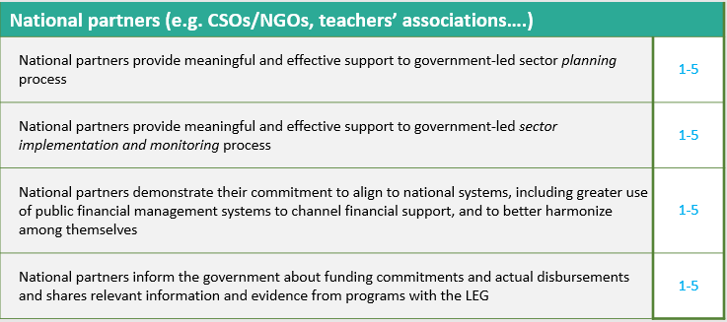
Example of assessment questions

Slide 24
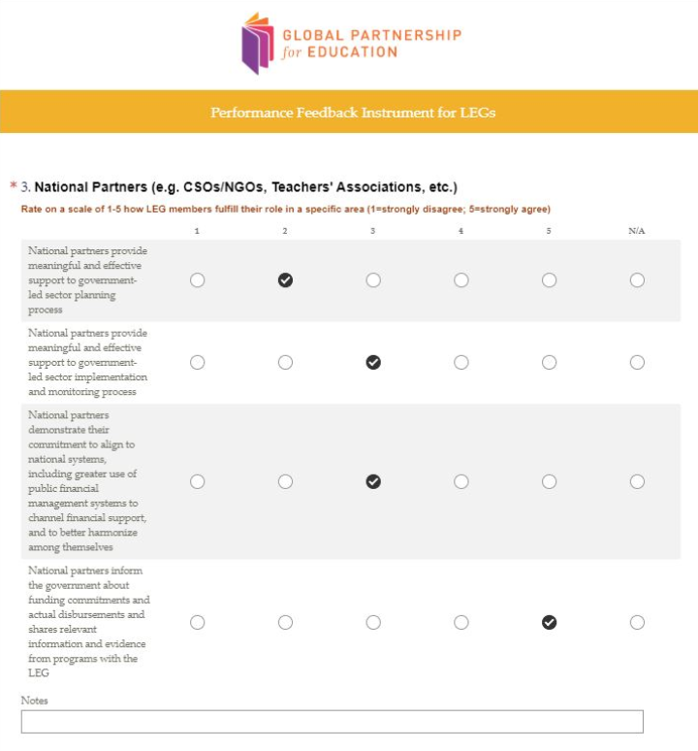
Formats
The tool in
SURVEY MONKEY
The performance feedback tool is available in:
PowerPoint, Word, Excel
+ Survey Monkey
Survey Monkey is in place to
facilitate individual or institutional responses
keep anonymity of responses (if desired)

Slide 25
.
Q & A

Slide 26
Today’s Agenda
Introductions
Overview of the pilot
Introducing the tools
Leg self-assessment tool
Performance feedback tool
Implementing the pilot
Getting started, decisions
Implementing the pilot
- Getting started, decisions

Slide 27
Decide on a task team
Under the leadership of the Ministry of Education, each LEG should appoint a task team to be responsible for the assessment. This team will
1
Define the assessment’s scope and modality
Ensure its adequate application
Compile and analyze the results
2
3

Slide 28
Decide on the scope of the tools
Analyze results and agree on follow-up actions
Entirety
Use all questions across areas and both tools
Selected
Select which tool and/or the core focus areas within each tool
Adapted
Tailor the tools as relevant
All or part of the tool Depending on country context, you may determine that only parts of the tool are important at this time for the LEG.
The assessment does not need to be carried out in one sitting

Slide 29
Decide on who will use the tool and how
Share and discuss results with the whole LEG
Collectively Complete assessment together as a LEG
Small group:
Complete assessment through a small group or task team
Individually Complete all or part of the assessment individually
PowerPoint
Excel
Excel
SurveyMonkey*
PowerPoint
Excel
Key to acknowledge who/what organizations participated in the assessment
* Survey Monkey is only for the
Performance Feedback Tool
Agree on
follow-up
actions

Slide 30
Decide what to do and when
October 2019
Decide to participate
Inform GPE Secretariat
Use the tool and results
Share your experience
Feedback & lessons
Participate in cross-country exchanges
Provide feedback on the pilot
Govt, CA wih LEG decide to participate in pilot
Advise GPE of decision to participate
Carry out LEG assessments and analyze results
Communication, progress update and feedback with GPE Secretariat
Introduction to tools
Support case by case
Leverage experiences
Compile learning
GPE Secretariat
Refinement of tools and guidance based on user-feedback and practices
April 2020
Decide WHEN and HOW to use the tools to fit needs and LEG calendar
INFORM THE SECRETARIAT

Slide 31
Transition from tools to focused action plan
Transition from the self-assessment tool towards a focused plan of
action to address weaker/priority areas to strengthen the LEG effectiveness.
Step 1
List items that scored 1-3
Step 2
Discuss which ones need to be addressed as priority
Step 3
Develop action plan for selected priorities
Prioritization grid
Action plan
Follow-up templates

Slide 32
Resources available
The tools in all formats (English, French, Portuguese)
Guiding principles towards effective LEGs
Guiding template for LEG TORs
Repository of LEG TORs (country examples)
FAQ
Additional practical guidance informed by the pilot
All resources for the LEG pilot are/will be available on
GPE website

Slide 33
Q & A
.

Slide 34
Primary contact
Country leads
Secretariat pilot team
Aya Kibesaki akibesaki@globalpartnership.org
Lucinda Ramos Alcantara lramosalcantara@globalpartnership.org
Katherina Hruskovec khruskovec@globalpartnership.org
Janne K. Perrier jperrier@globalpartnership.org
Judith Friedman Judith@iodparc.com

